Slide 2
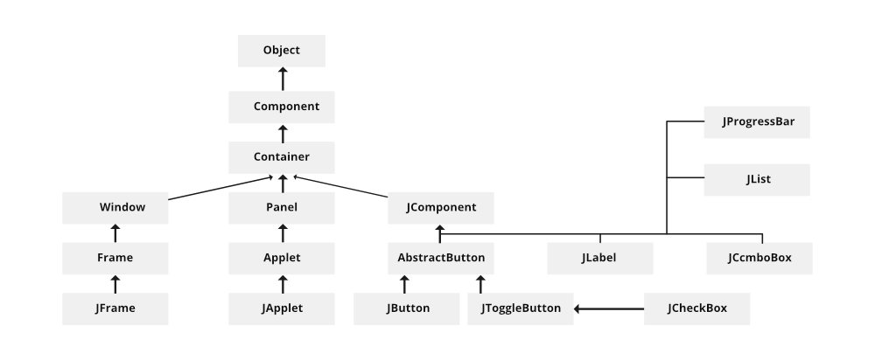
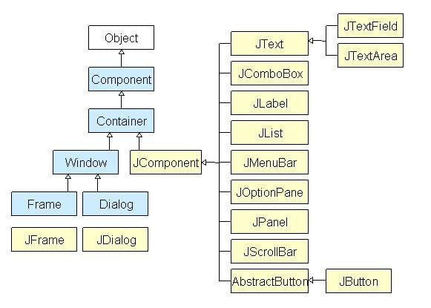

Slide 3
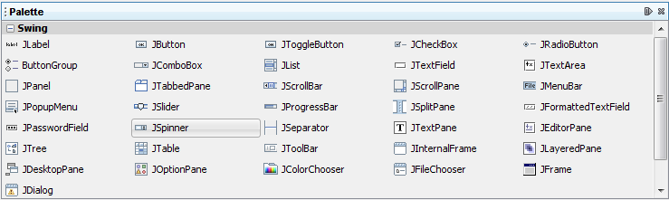
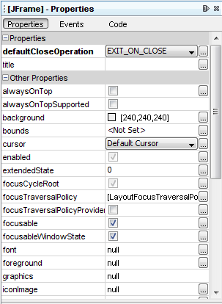
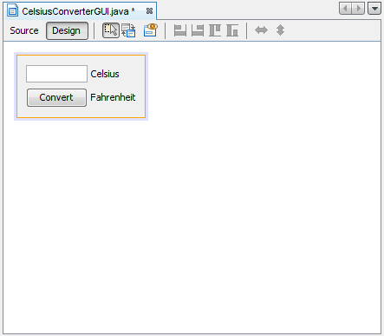

Slide 4
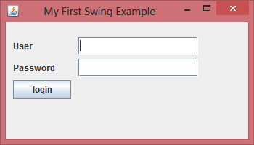

Slide 5
import javax.swing.JButton;
import javax.swing.JFrame;
import javax.swing.JLabel;
import javax.swing.JPanel;
import javax.swing.JPasswordField;
import javax.swing.JTextField;
public class SwingFirstExample {
public static void main(String[] args) {
JFrame frame = new JFrame("My First Swing Example");
frame.setSize(350, 200);
frame.setDefaultCloseOperation(JFrame.EXIT_ON_CLOSE);
JPanel panel = new JPanel();
frame.add(panel);
placeComponents(panel);
frame.setVisible(true);
}
private static void placeComponents(JPanel panel) {
panel.setLayout(null);
JLabel userLabel = new JLabel("User");
userLabel.setBounds(10,20,80,25);
panel.add(userLabel);
JTextField userText = new JTextField(20);
userText.setBounds(100,20,165,25);
panel.add(userText);
JLabel passwordLabel = new JLabel("Password");
passwordLabel.setBounds(10,50,80,25);
panel.add(passwordLabel);
JPasswordField passwordText = new JPasswordField(20);
passwordText.setBounds(100,50,165,25);
panel.add(passwordText);
JButton loginButton = new JButton("login");
loginButton.setBounds(10, 80, 80, 25);
panel.add(loginButton);
}
}

Slide 6
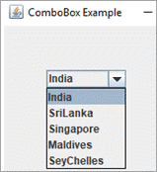
comboBox
import javax.swing.*;
class ComboBoxExample {
JFrame frame;
ComboBoxExample(){
frame=new JFrame("ComboBox Example");
//create a string array
String country[]={"India","SriLanka","Singapore","Maldives","SeyChelles"};
//create a combobox object with given string array
JComboBox countries=new JComboBox(country);
countries.setBounds(50, 50,90,20);
frame.add(countries); //add it to the frame
frame.setLayout(null);
frame.setSize(200,300);
frame.setVisible(true);
}
}
public class Main {
public static void main(String arg[]) {
new ComboBoxExample();
}
}

Slide 7
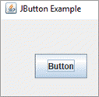
Button
import javax.swing.*;
public class Main {
public static void main(String[] args) {
JFrame frame=new JFrame("JButton Example"); //create JFrame object
JButton button=new JButton("Button"); //Create a JButton object
button.setBounds(50,50,75,35); //set dimensions for button
frame.add(button); //add button to the frame
frame.setSize(250,200);
frame.setLayout(null);
frame.setVisible(true);
}
}

Slide 8
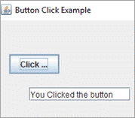
import javax.swing.*;
import java.awt.event.*;
public class Main {
public static void main(String[] args) {
JFrame frame=new JFrame("Button Click Example");
final JTextField text_field=new JTextField(); //JTextField object
text_field.setBounds(50,100, 150,20);
JButton click_button=new JButton("Click Me!!!"); //JButton object
click_button.setBounds(20,50,75,30);
click_button.addActionListener(new ActionListener(){ //add an event and take action
public void actionPerformed(ActionEvent e){
text_field.setText("You Clicked the button");
}
});
//add button and textfield to the frame
frame.add(click_button);frame.add(text_field);
frame.setSize(400,400);
frame.setLayout(null);
frame.setVisible(true);
}
}

